Slide 1
Growth
Understanding growth, the link between plants and the environment, and between micro-organisms and vaccines.

Slide 2









What is growth
& what things grow?
Hands up

Slide 3

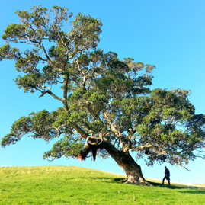

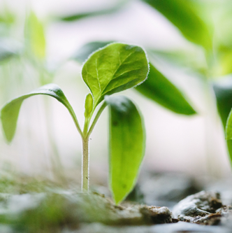

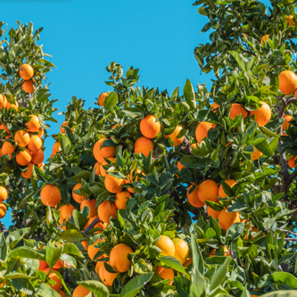


Examples

Slide 4



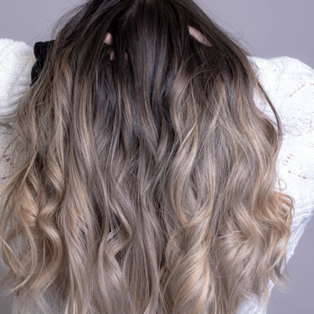
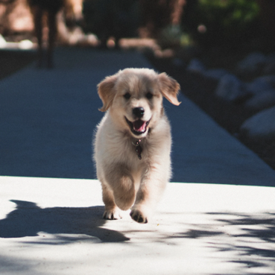
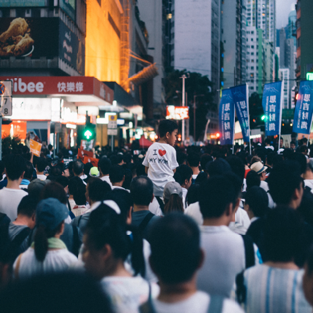


Examples

Slide 5



How can you investigate growth?

Slide 6
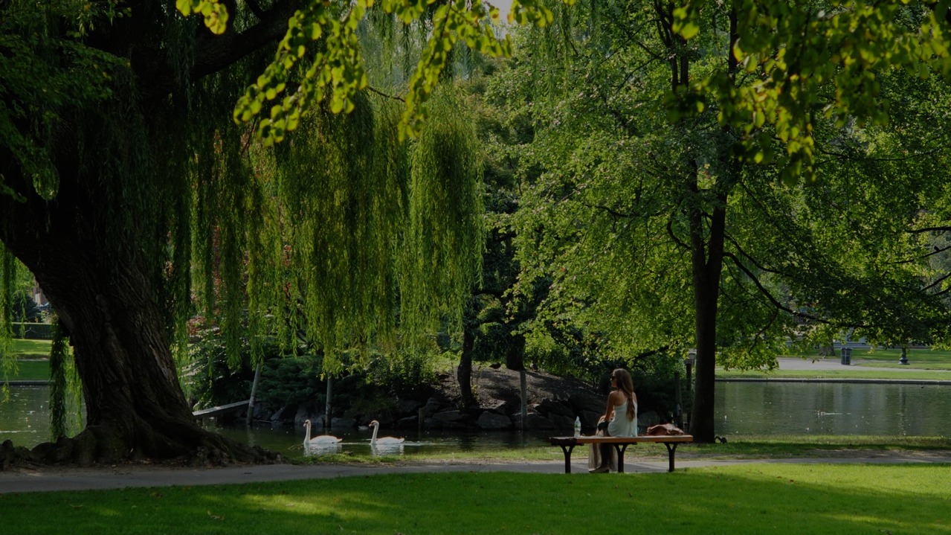







You could always explore plants in your local area

Slide 7

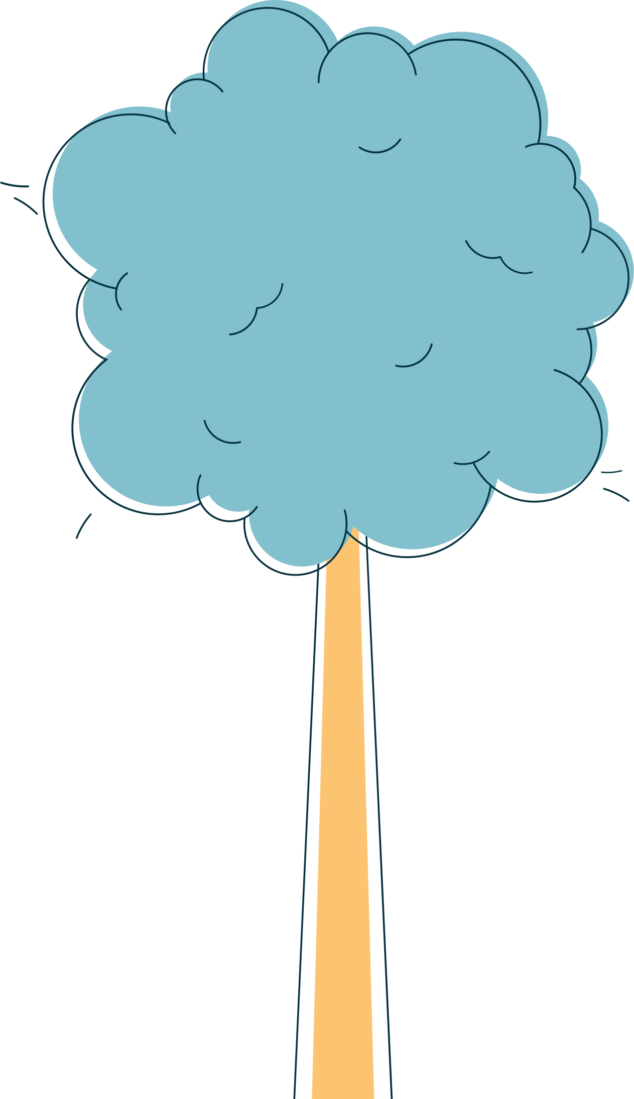






What do young plants look like?
How do young and old plants look different?

Slide 8
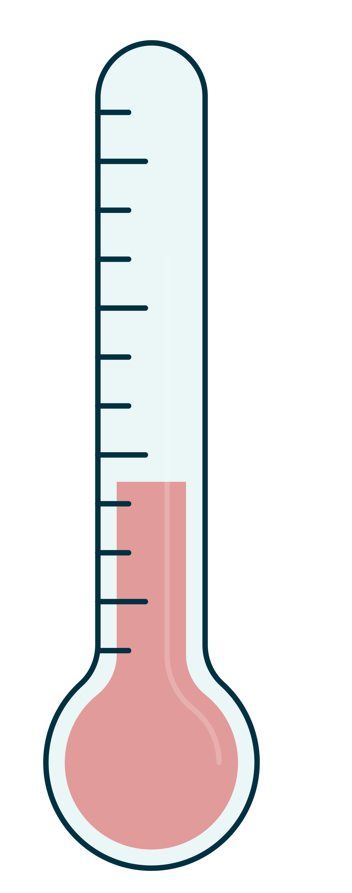
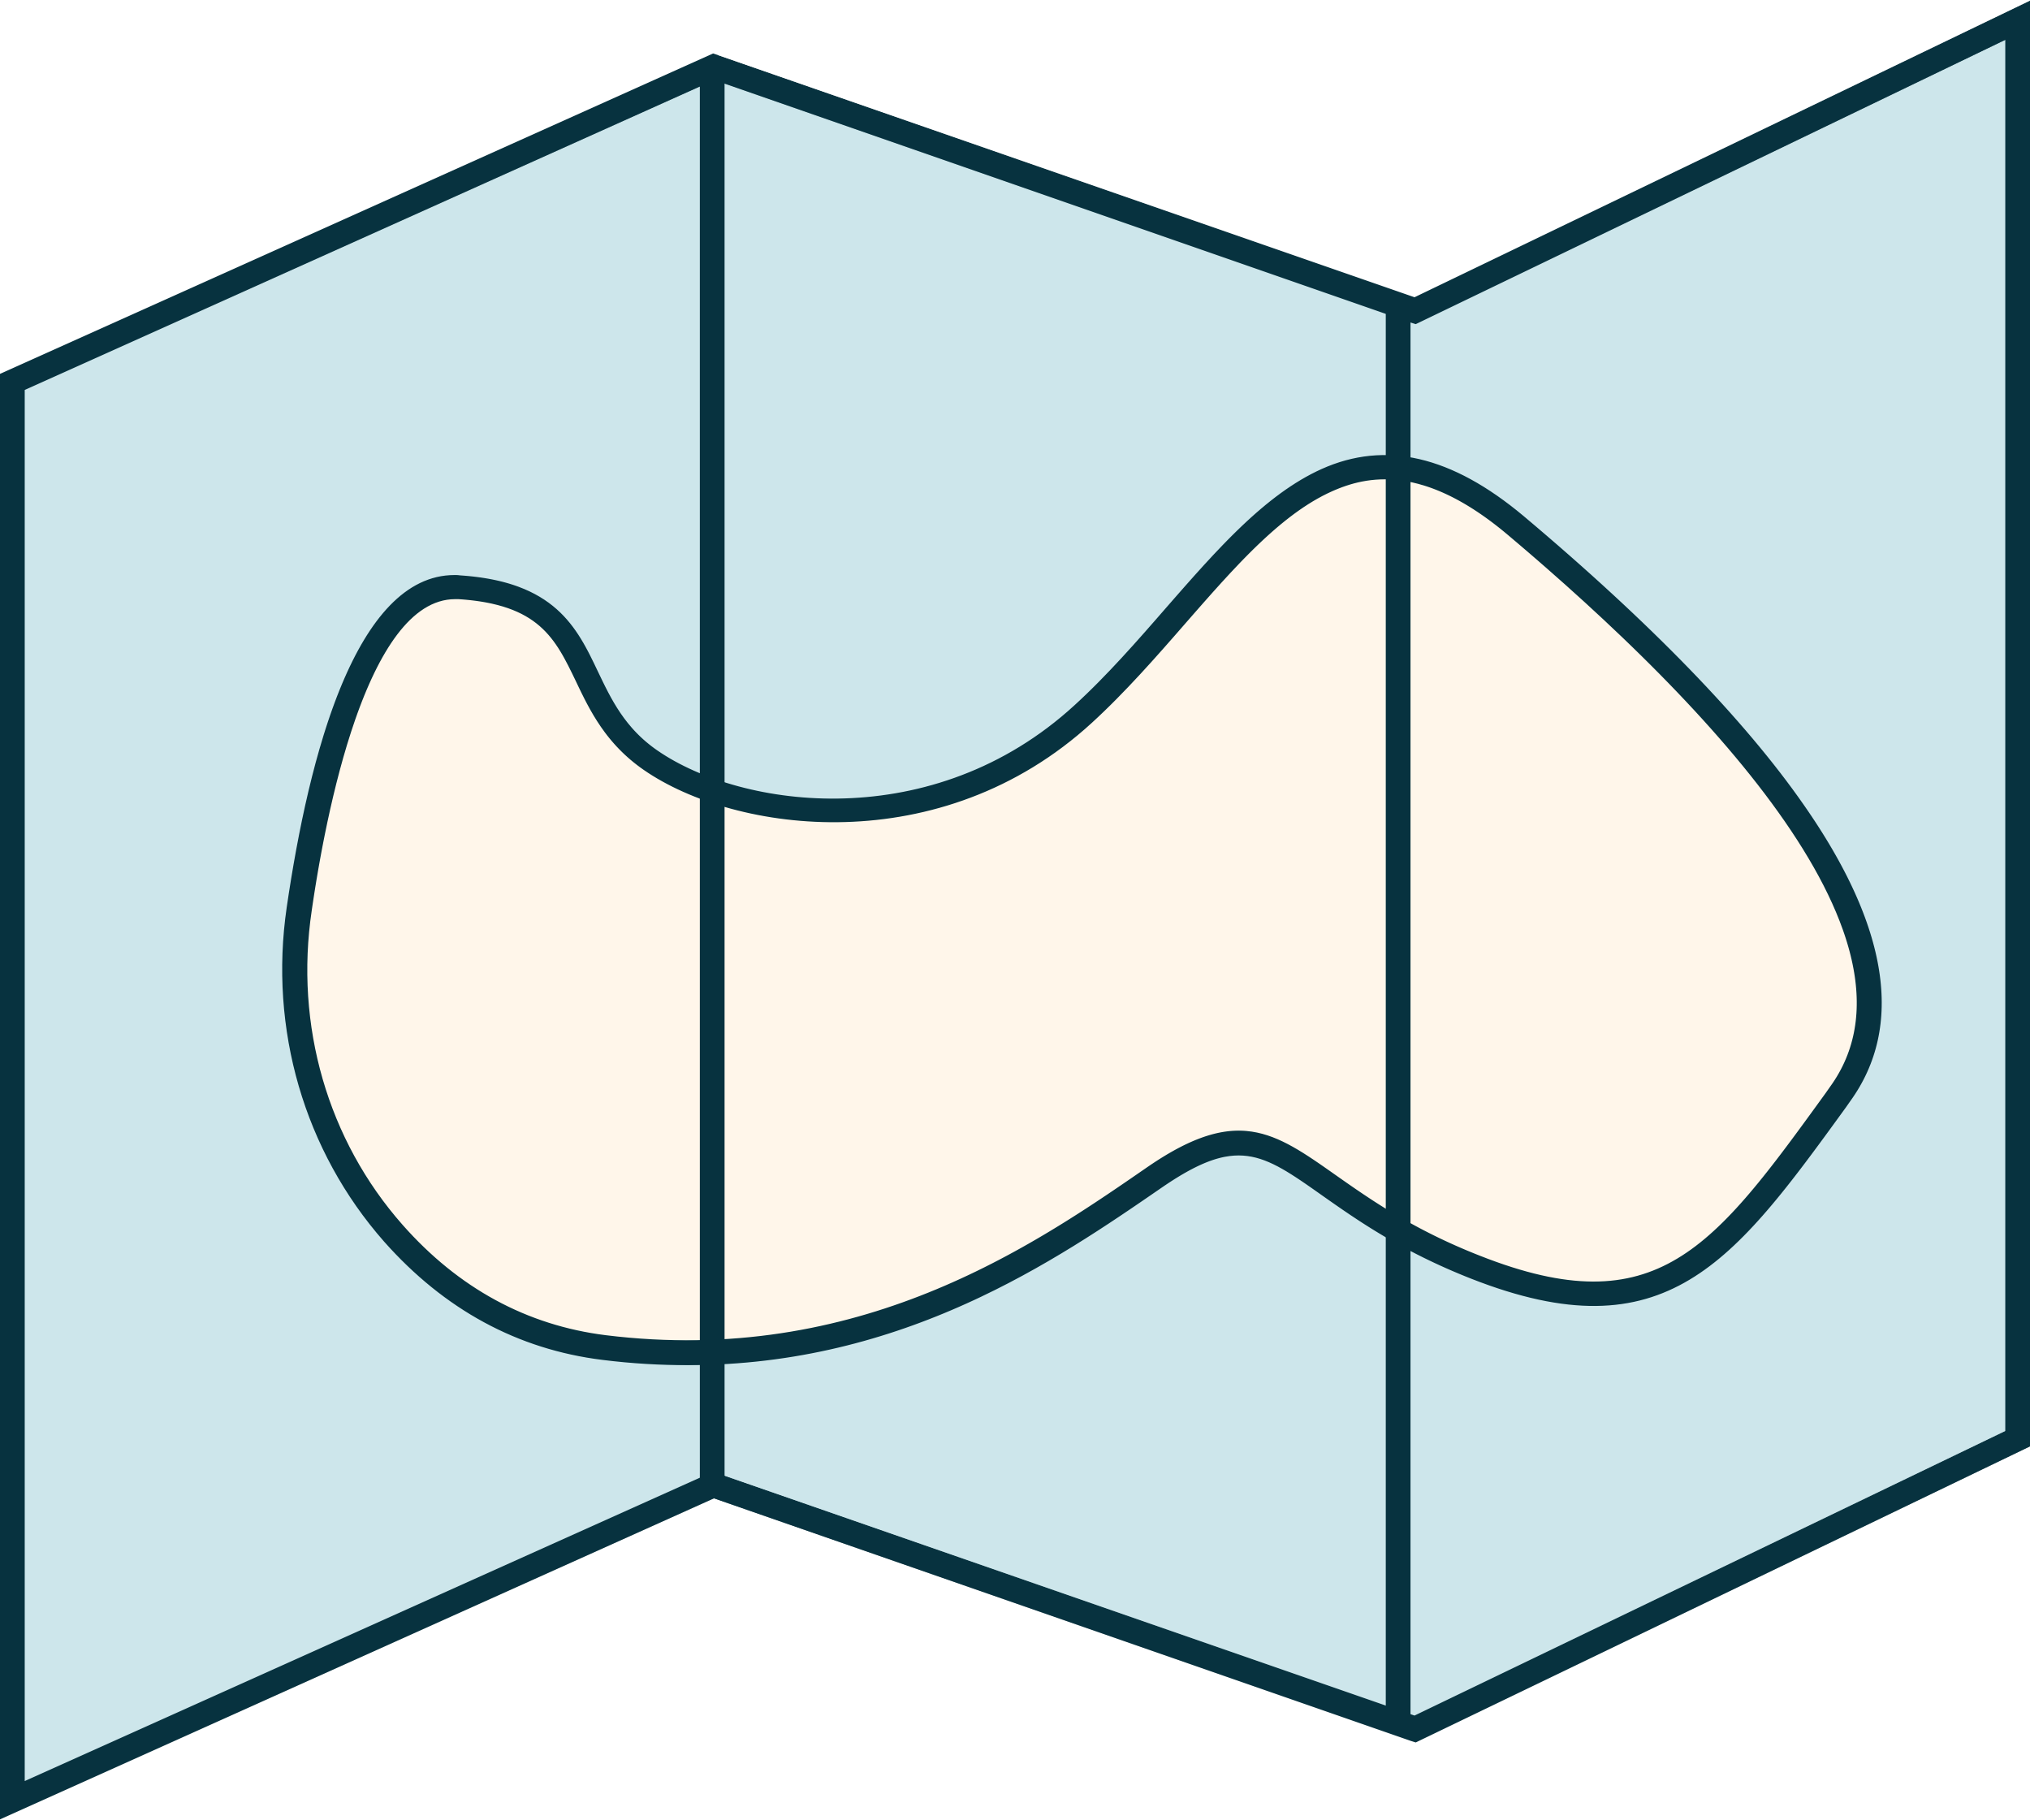


Do plants grow better in certain areas?
Or certain times of the year?
Map of local area

Slide 9
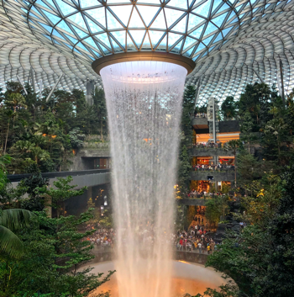
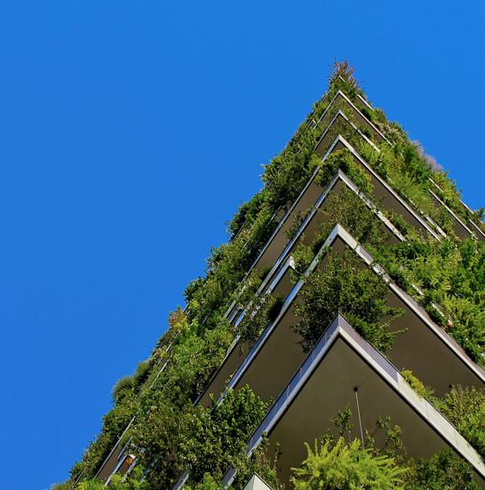


Where is the strangest place you have seen plants grow?

Slide 10

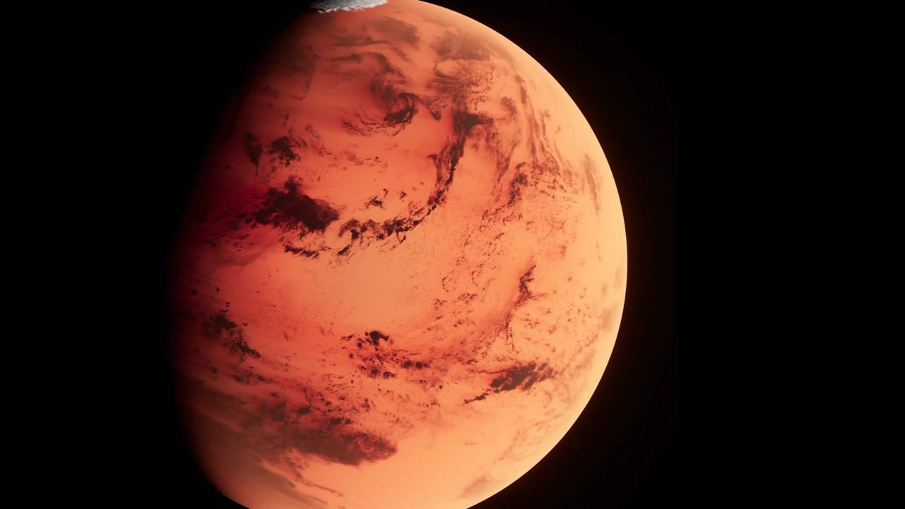

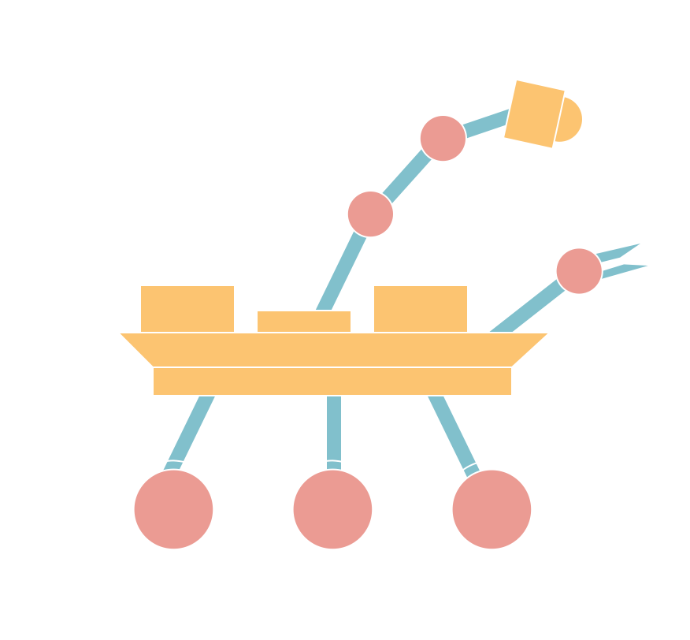



It is not just things we can see that grow…
Space rovers on the planet Mars are being used to explore the possibilities of living things growing on Mars – if there are living things on Mars, we may not be able to see them with the human eye

Slide 11
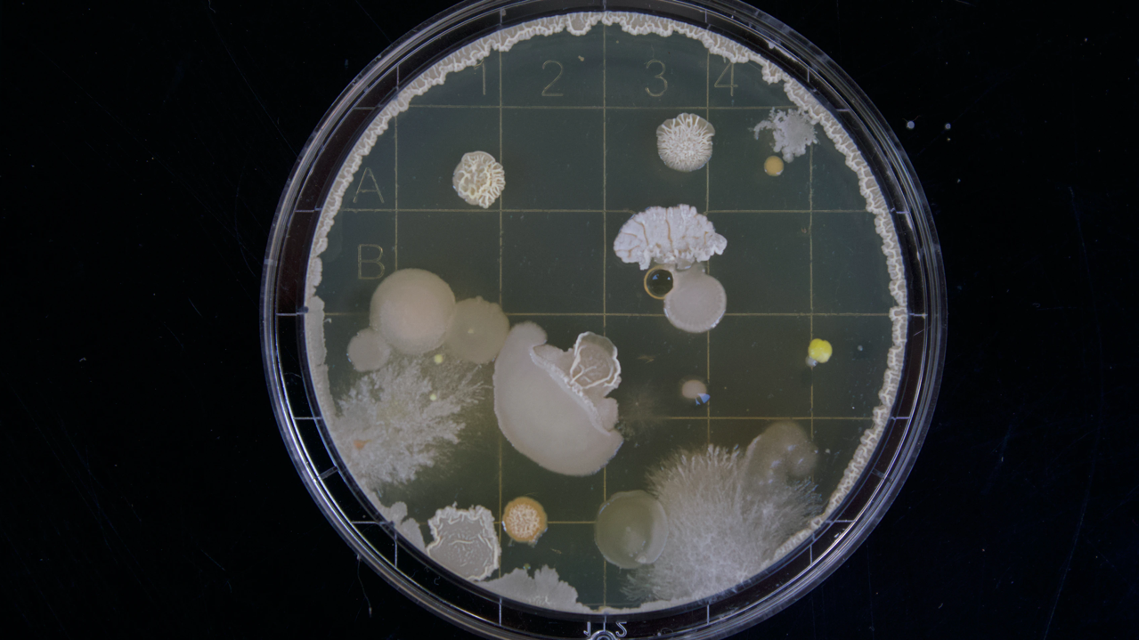


On Earth there are things we can’t see with the human eye that grow – like micro-organisms but you might know them as germs, or bugs or possibly microbes.

Slide 12



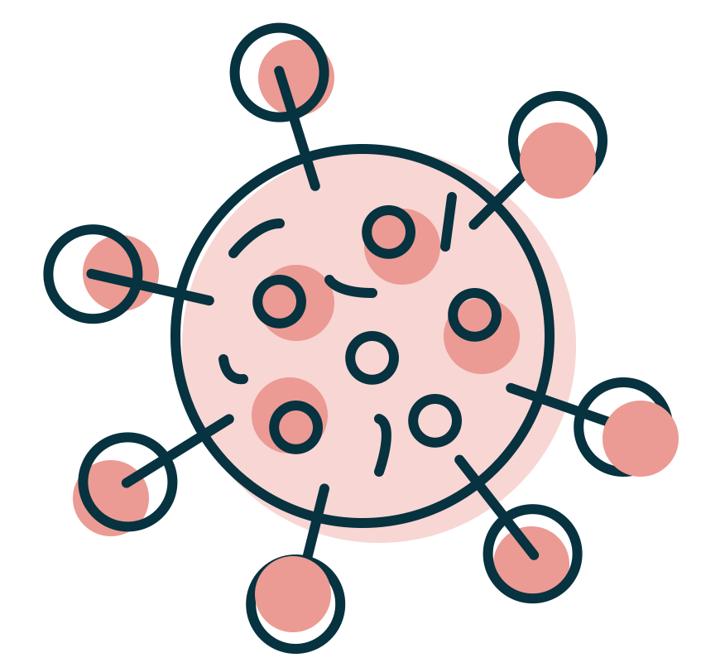
There are 3 types of micro-organisms (microbes)
Fungi
Bacteria
Viruses

Slide 13




A lot are good and really helpful
Bread
Yoghurt
Yeast (a fungus) helps us make
Bacteria that helps us make

Slide 14
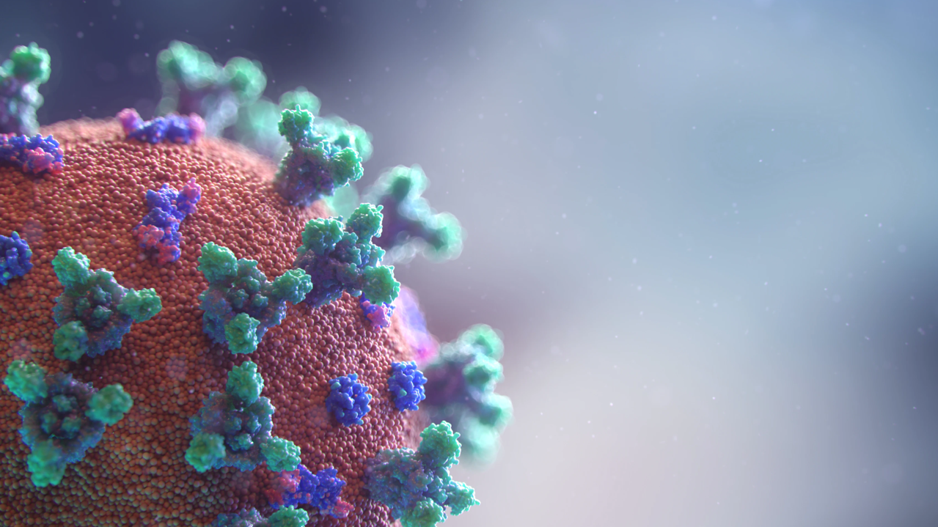
But some are not so good and can make people and other animals ill

Slide 15



Micro-organisms that make us ill

Slide 16
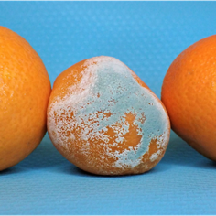
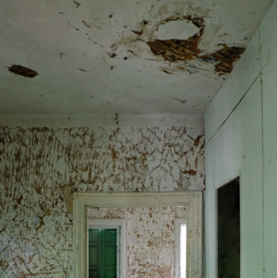

Mould is a fungus – it can grow on food and would make us ill if we ate it

Slide 17
There are different viruses that can make us ill too – like the virus that makes us sneeze, have a runny nose and sore throat – the common cold.
It is also a virus that causes covid-19.

Slide 18
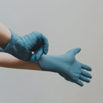

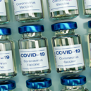
Lots of things in everyday life have had to change because of covid-19.
What can you do to stop a virus population from growing?

Slide 19



At the same time, scientists have wanted to do all they can to help stop the spread of covid.

Slide 20







Stopping growth of the covid virus population

Slide 21


A key thing many scientists have been doing to stop the virus population from growing is making something called a vaccine which could be given to people to stop them getting ill from covid.

Slide 22

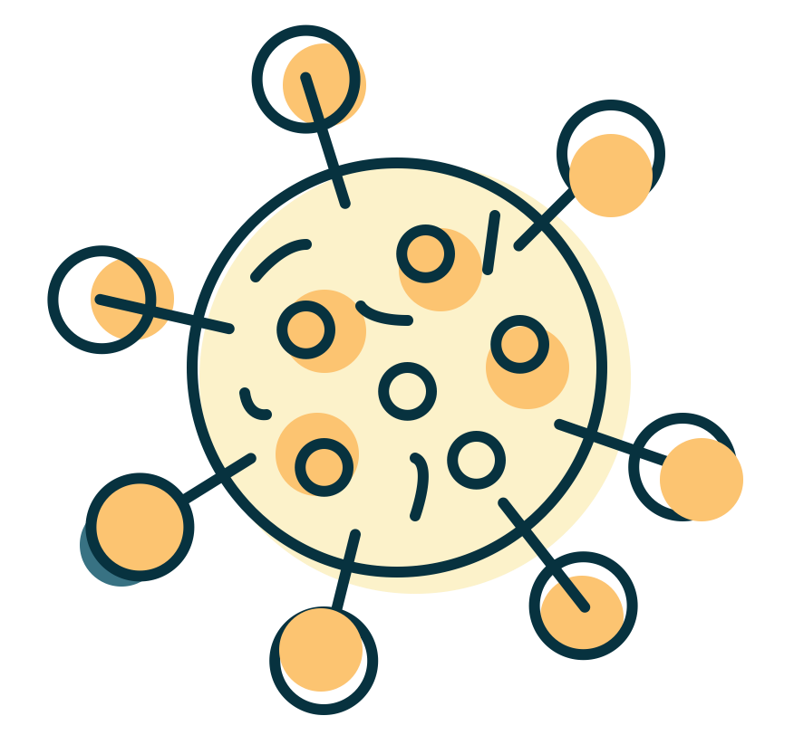



FACT: Scientists know that different vaccines are very good at stopping different viruses from making people very ill.

Slide 23
FACT: Scientists have been making vaccines for many years and are currently working on developing over 200 new vaccines

Slide 24
FACT: Every year, 2 – 3 million lives are saved across the world thanks to a vaccine

Slide 25

Vaccines for covid continue to be given to people to stop them from getting very ill

Slide 26
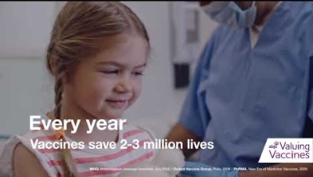
Scientists continue to work on new vaccines with one clear ambition…
For more information, visit: https://www.valuingvaccines.org.uk/

Slide 27
Thank you
The Association of the British Pharmaceutical Industry
A company limited by guarantee registered in England & Wales number 09826787
Registered office 7th Floor, Southside, 105 Victoria Street, London SW1E 6QT

